Slide 1
Building a GPU-Accelerated Retrieval Augmented Generation (RAG) Pipeline
Notes:
Welcome to our course on Building RAG Agents with LLMs!
REMIND STUDENTS TO START UP THEIR COURSE ENVIRONMENT!
LLMs: Large Language Models which take in, produce, or otherwise reason with text. We’ll learn to make more complex systems
Course Topics:
Creating chatbot applications capable of dialogue management and retrieval augmented generation.
Built from the ground up using foundation models which can be deployed on your own compute.
Leveraging current best practices from open-source frameworks like LangChain.

Slide 2
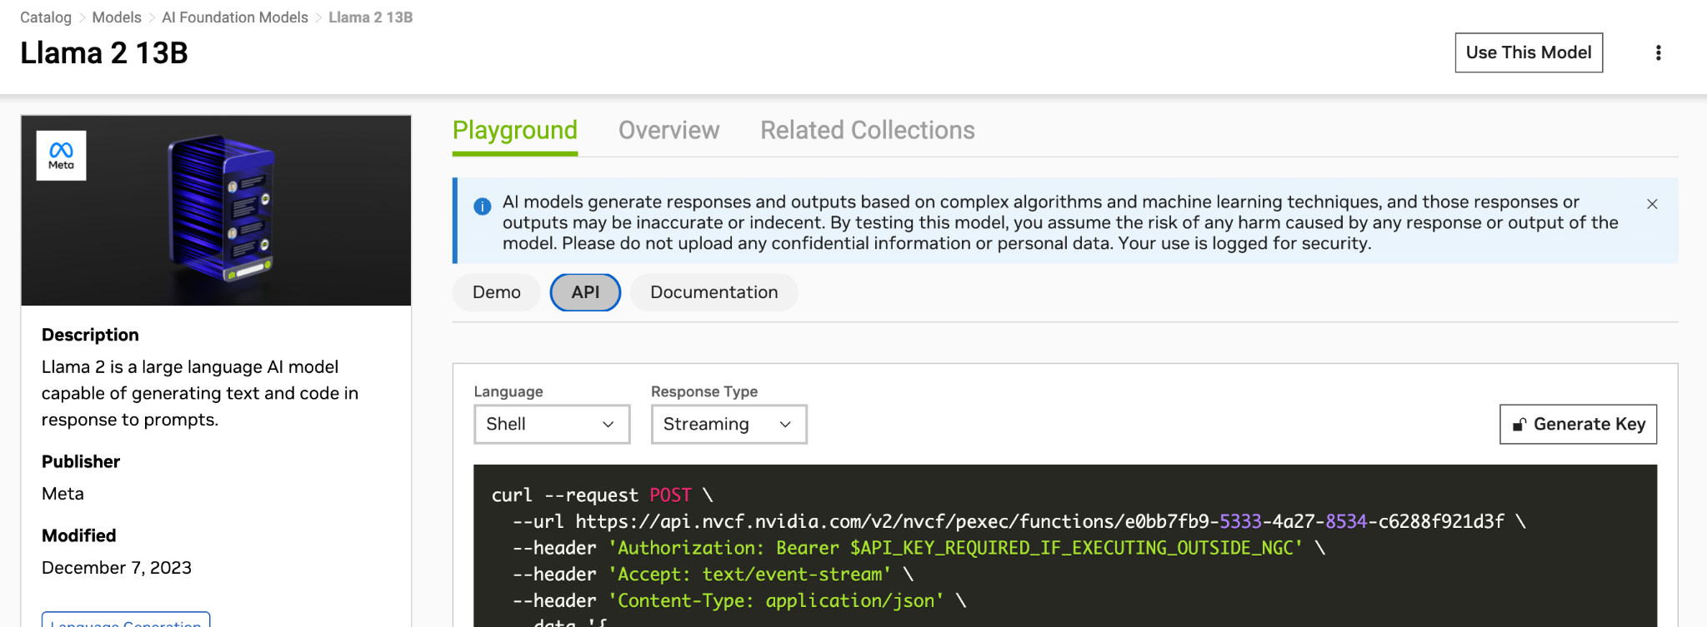
How to generate your own NVIDIA API key?
visit ngc.nvidia.com
sign in with your email and password
if you don’t have an account sign up
Select an LLM model (e.g. LLama 13b) in the catalog
click on the API tab and generate your NV API key

Slide 3
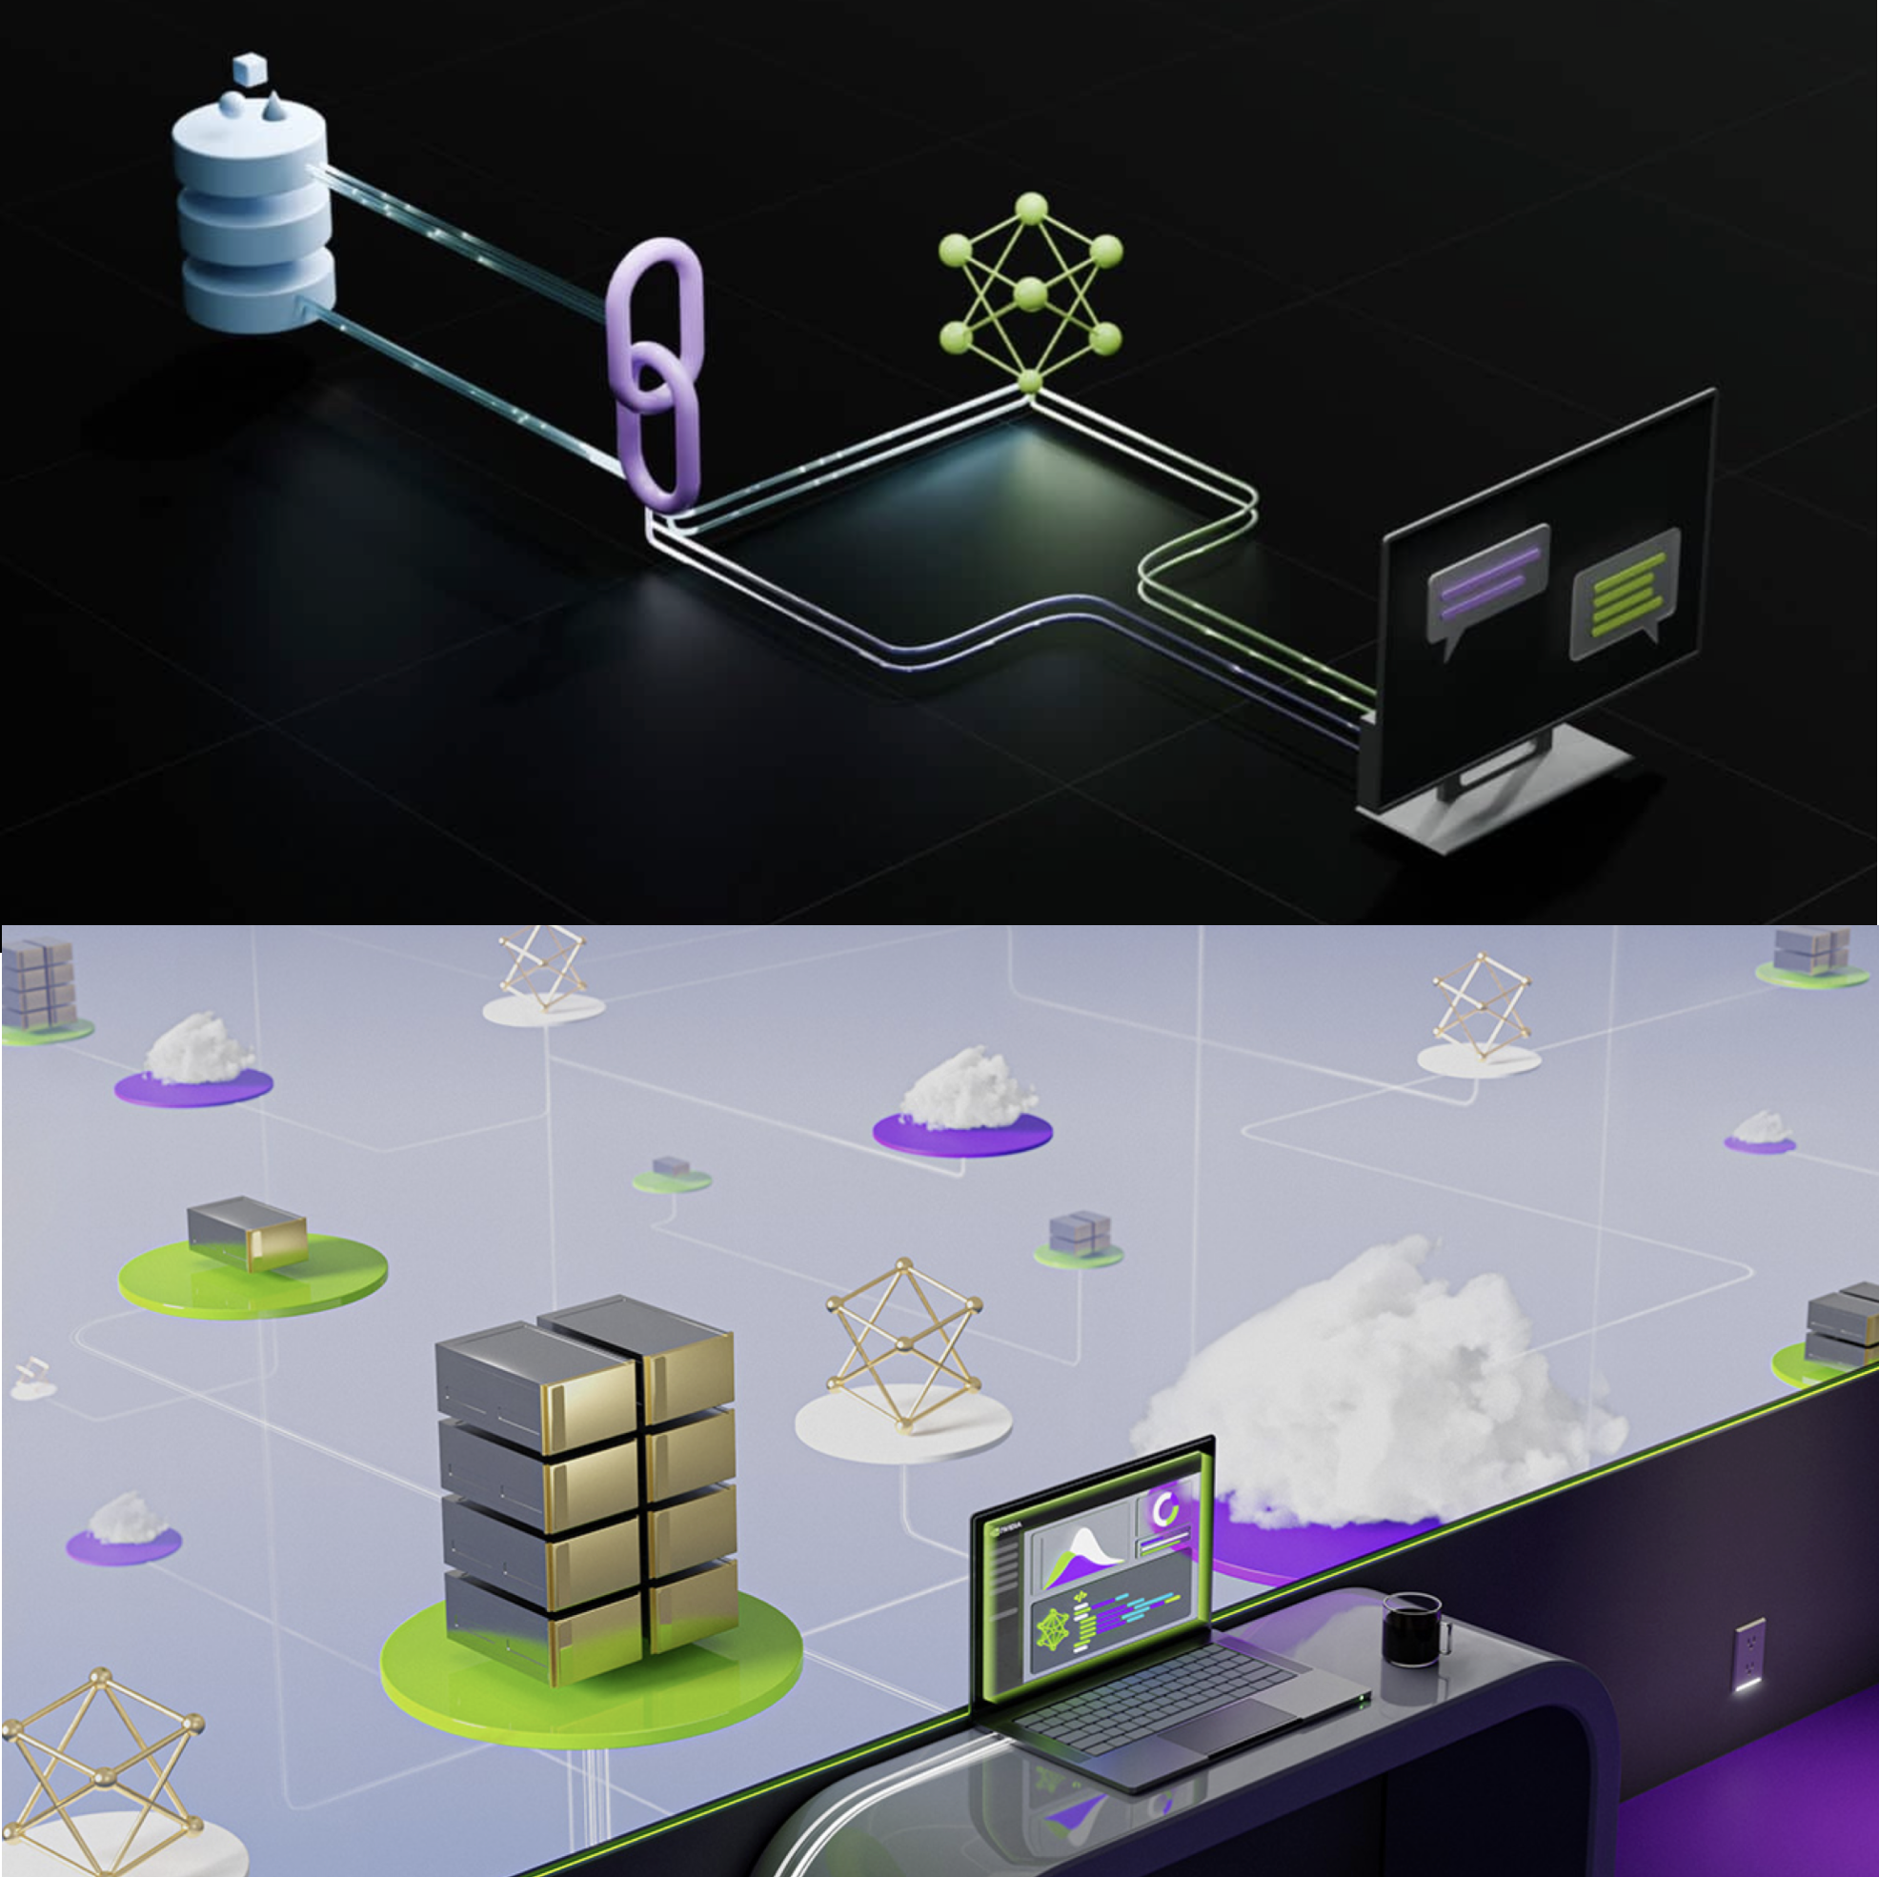
Agenda
Intro to Large Language Models (LLMs)
Chat with your data with LLMs
What is RAG? Why we need it?
Optimized RAG applications with NVIDIA NeMo
NVIDIA Foundation Models
NVIDIA Microservices
RAG Evaluation
Retrieval Evaluation
Generator Evaluation
Summary and Q&A

Slide 4
Intro to Large Language Models (LLMs)

Slide 5
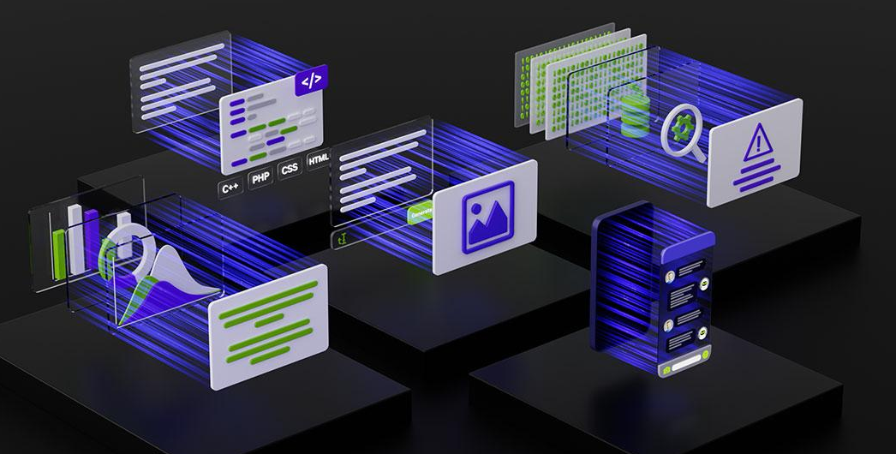
Large Language Models (LLMs)
Backbones for Language Understanding
Backbones for language tasks, including classification and generation.
https://www.nvidia.com/content/dam/en-zz/Solutions/lp/large-language-models-ebook/nvidia-llm-ebook-og.jpg
Notes:
Welcome to our course on Building RAG Agents with LLMs!
LLMs: Large Language Models which take in, produce, or otherwise reason with text. We’ll learn to make more complex systems
Course Topics:
Creating chatbot applications capable of dialogue management and retrieval augmented generation.
Built from the ground up using foundation models which can be deployed on your own compute.
Leveraging current best practices from open-source frameworks like LangChain.

Slide 6
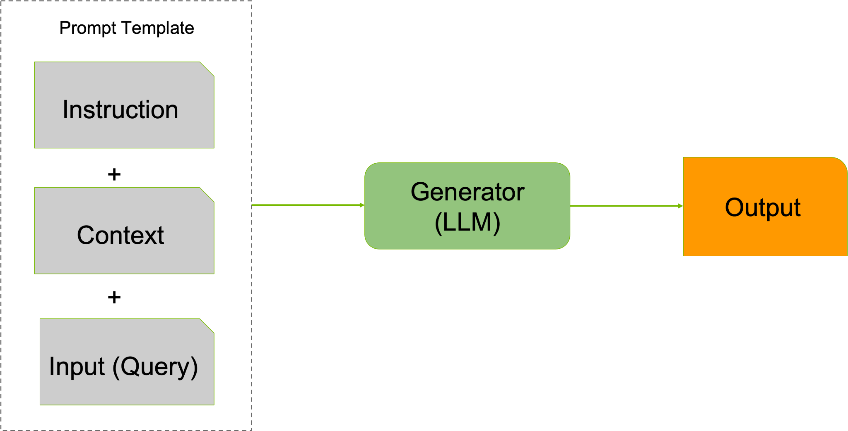
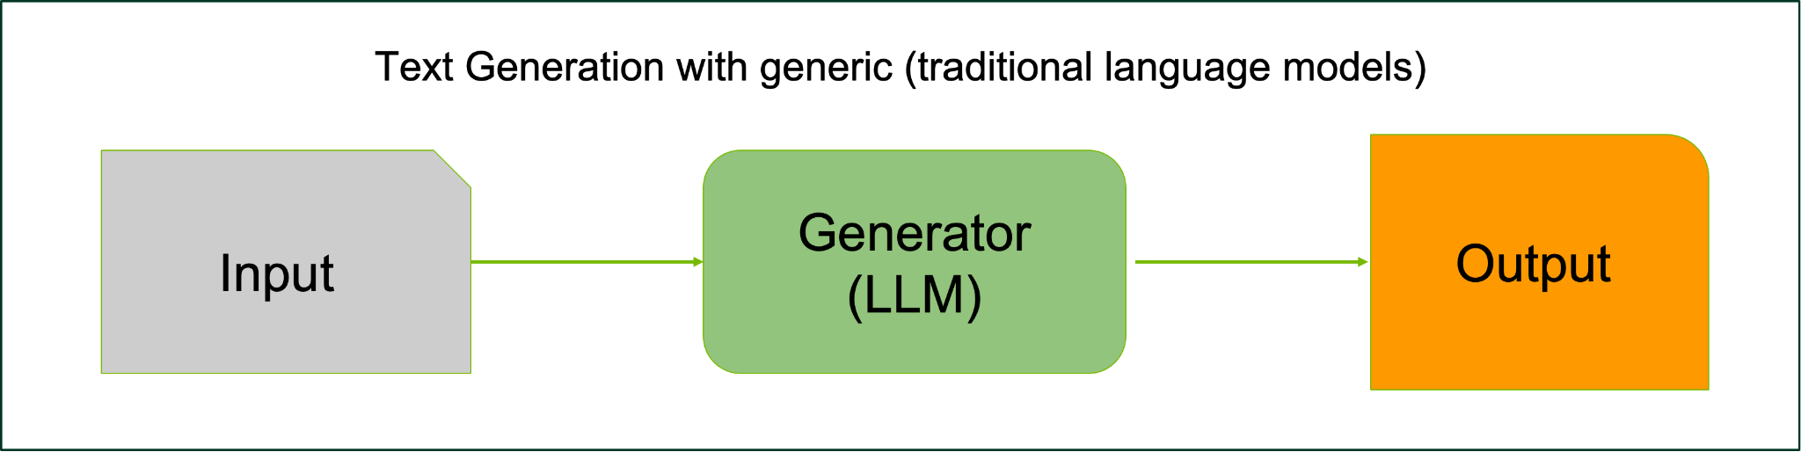
Large Language Models (LLMs)
Backbones for Language Understanding
LLMs are a type of generative AI that are trained on text and produce textual content (actually now we can generate more than text)
mainly refer to transformer-based neural language models
contain tens to hundreds of billions of parameters
pretrained on massive text data
exhibit stronger language understanding and generation abilities
evolved from traditional to instruction-tuned and/or dialog-tuned models
The
sky
is
The
sky
is
blue
Notes:
Welcome to our course on Building RAG Agents with LLMs!
LLMs: Large Language Models which take in, produce, or otherwise reason with text. We’ll learn to make more complex systems
Course Topics:
Creating chatbot applications capable of dialogue management and retrieval augmented generation.
Built from the ground up using foundation models which can be deployed on your own compute.
Leveraging current best practices from open-source frameworks like LangChain.

Slide 7
Chat with your data using LLMs

Slide 8

Are LLMs enough?
Chat with You Data Applications
LIMITATIONS:
Outdated training data
Domain knowledge deficit
Hallucinations (generating misinformation)
Catastrophic forgetting
Reasoning Failure
Biased information
Removing “information” from the LLM “weights”
who played Oppenheimer in the Oppenheimer movie?
Prompt
Input: {input}
LLM
The role of J. Robert Oppenheimer in the 2005 film "Oppenheimer" was portrayed by actor Sir Anthony Hopkins.
Notes:
Welcome to our course on Building RAG Agents with LLMs!
LLMs: Large Language Models which take in, produce, or otherwise reason with text. We’ll learn to make more complex systems
Course Topics:
Creating chatbot applications capable of dialogue management and retrieval augmented generation.
Built from the ground up using foundation models which can be deployed on your own compute.
Leveraging current best practices from open-source frameworks like LangChain.

Slide 9
What is Retrieval-Augmented Generation (RAG)?
Retrieval-augmented generation (RAG) is a technique/process for enhancing the accuracy and reliability of generative AI models with facts fetched from external sources. RAG generates up-to-date and domain-specific answers by connecting a Large Language Model (LLM) to your custom/enterprise data.
There are several advantages of using RAG:
Empowering LLM solutions with real-time data access: get the information you need more quickly
Preserving data privacy
Mitigating LLM hallucinations: accessing the most relevant and recent information
Enabling LLMs to use priority information without retraining/finetuning the mode
[1] https://developer.nvidia.com/blog/rag-101-demystifying-retrieval-augmented-generation-pipelines/
[2] Retrieval-Augmented Generation for Knowledge-Intensive NLP Tasks
Notes:
Welcome to our course on Building RAG Agents with LLMs!
LLMs: Large Language Models which take in, produce, or otherwise reason with text. We’ll learn to make more complex systems
Course Topics:
Creating chatbot applications capable of dialogue management and retrieval augmented generation.
Built from the ground up using foundation models which can be deployed on your own compute.
Leveraging current best practices from open-source frameworks like LangChain.

Slide 10
Example of Retrieval-Augmented Generation (RAG)
User Question: What is GTC?
Input to the generator (LLM):
“
Context information is below.
---------------------
Nvidia GTC (GPU Technology Conference) is a global artificial intelligence (AI) conference for developers that brings together developers, engineers, researchers, inventors, and IT professionals.[1] Topics focus on AI, computer graphics, data science, machine learning and autonomous machines. Each begins with a keynote from Nvidia CEO and Founder Jensen Huang, followed by a variety of and talks with experts from around the world.
It originated in 2009 in San Jose, California, with an initial focus on the potential for solving computing challenges through GPUs.[2] In recent years, the conference focus has shifted to various applications of artificial intelligence and deep learning, including: self-driving cars, healthcare, high performance computing, professional visualization, and Nvidia Deep Learning Institute (DLI) training.[3]
---------------------
Given the context information and not prior knowledge, answer the query.
Query: What is GTC?
Answer:
”
Context information is below.
---------------------
Nvidia GTC (GPU Technology Conference) is a global artificial intelligence (AI) conference for developers that brings together developers, engineers, researchers, inventors, and IT professionals.[1] Topics focus on AI, computer graphics, data science, machine learning and autonomous machines. Each begins with a keynote from Nvidia CEO and Founder Jensen Huang, followed by a variety of and talks with experts from around the world.
It originated in 2009 in San Jose, California, with an initial focus on the potential for solving computing challenges through GPUs.[2] In recent years, the conference focus has shifted to various applications of artificial intelligence and deep learning, including: self-driving cars, healthcare, high performance computing, professional visualization, and Nvidia Deep Learning Institute (DLI) training.[3]
---------------------
Given the context information and not prior knowledge,
answer the query.
Query: What is GTC?
Answer:
Bold: Prompt Template
Normal: User-Depending Data
[1] https://docs.llamaindex.ai/en/stable/examples/prompts/prompts_rag.html
Notes:
Welcome to our course on Building RAG Agents with LLMs!
LLMs: Large Language Models which take in, produce, or otherwise reason with text. We’ll learn to make more complex systems
Course Topics:
Creating chatbot applications capable of dialogue management and retrieval augmented generation.
Built from the ground up using foundation models which can be deployed on your own compute.
Leveraging current best practices from open-source frameworks like LangChain.

Slide 11
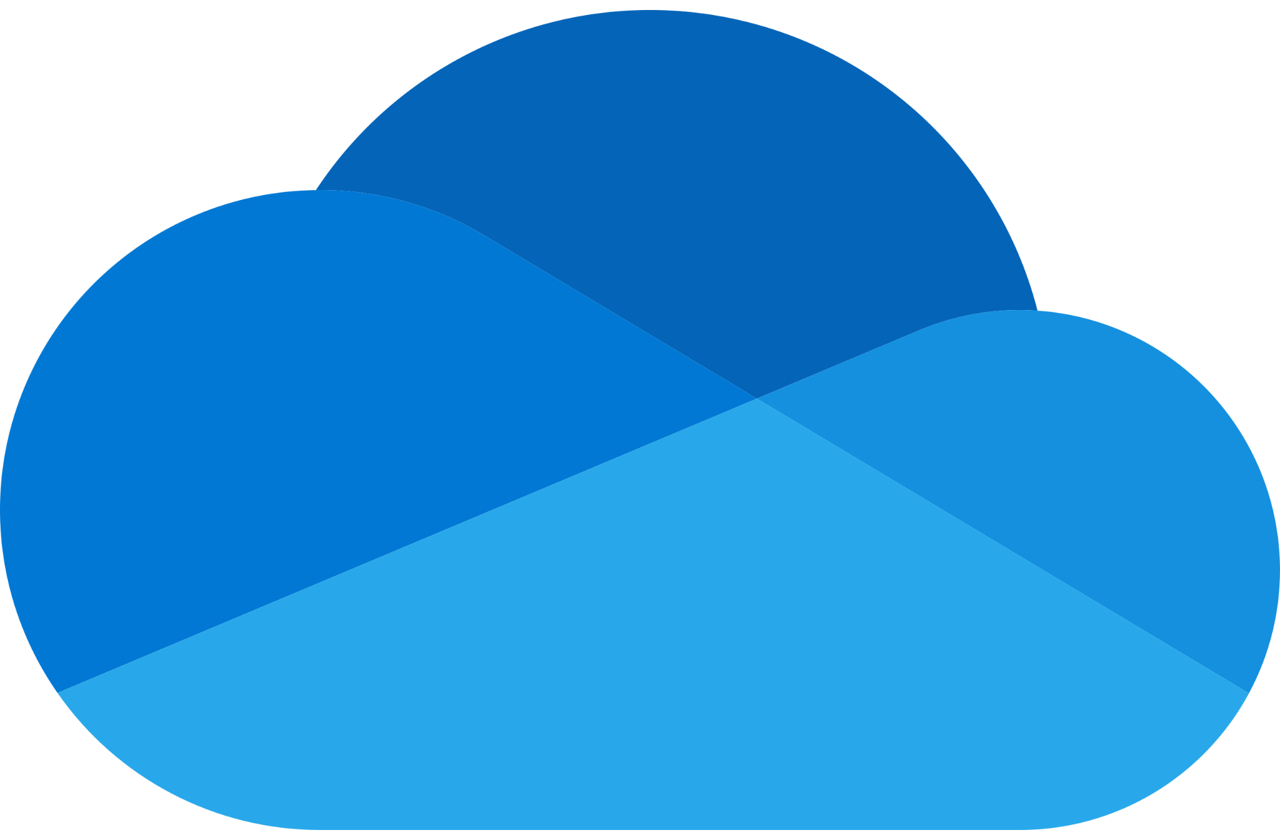
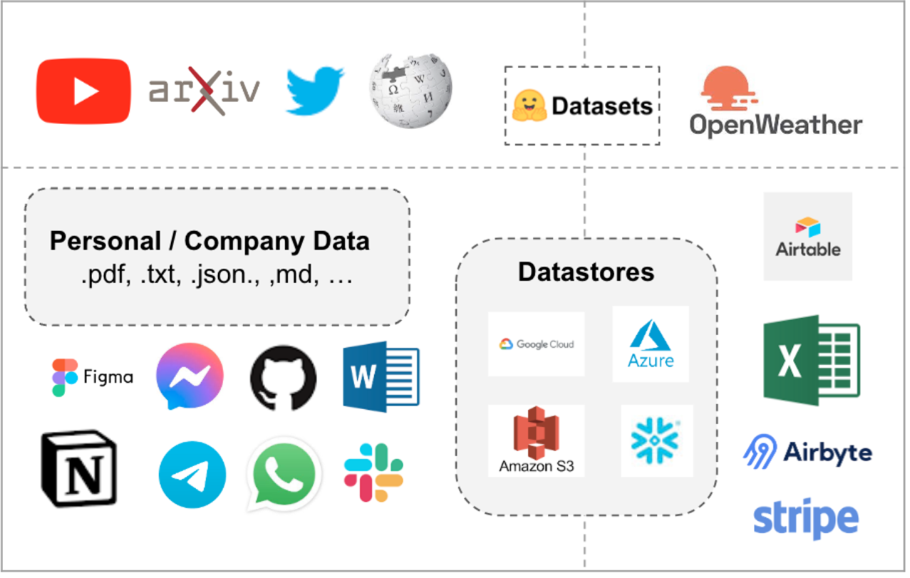
Chat with Your Enterprise Data
Company
Database
Sure, I can answer by referring this document..
Prompt
Context Question
LLM
Local files
Your Device
Notes:
Reasoning about documents is great!
Why not feed documents into an LLM as context?
Use Case: Feed documents by default as a consistent context. Corporate knowledge base?
Use Case: Allow users to upload their own documents and use the data as context. Productivity tool?
Problem: How do we feed a document into our LLM?
Solution: Make connectors to convert to information-dense plaintext.
Problem: But what about for longer-form inputs? Can our LLM handle it? Can it still follow instructions? (Probably not)

Slide 12
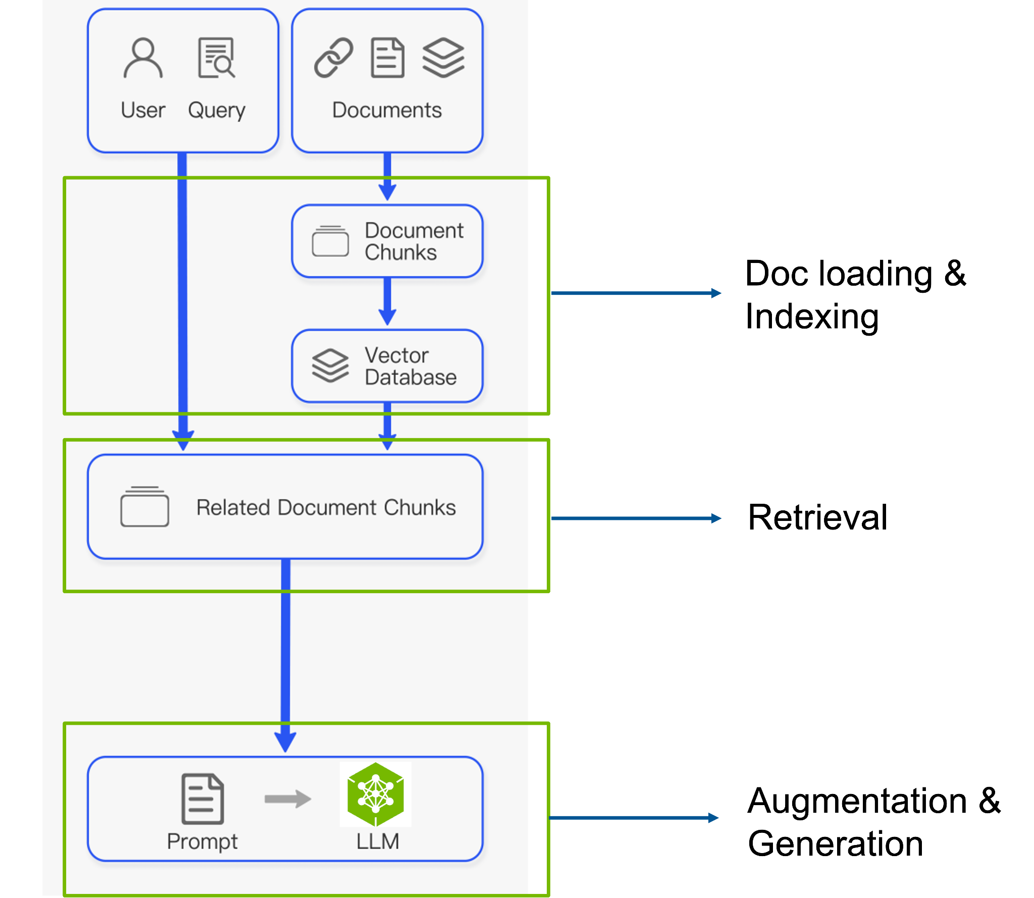
A Naive RAG pipeline
Image adapted from Gao et al. 2024 paper: https://arxiv.org/pdf/2312.10997.pdf

Slide 13
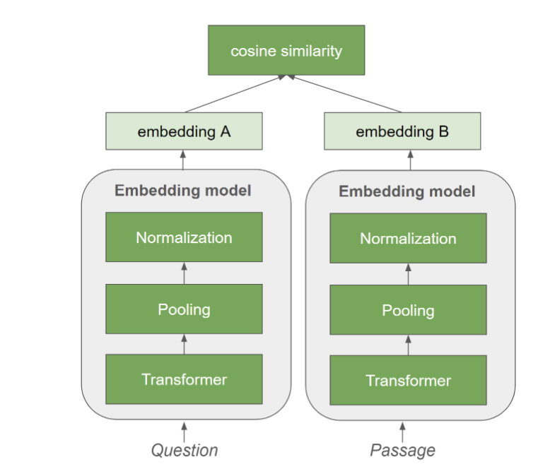
Embedding Model as Dense Retriever
Embedding Model
Using pre-trained transformer model to extract text embedding to represent the context
Embeddings can be indexed by approximate nearest neighbor (ANN) algorithm
Efficient to retrieve relevant documents with ANN index
Model needs to be trained so that question-answer pairs are close in the embedding space
Advantage: Embeddings represent semantic meaning - can handle “synonyms” automatically
Disadvantage: Embeddings might not understand specific keywords which haven’t appeared in the training dataset
Notes:
Welcome to our course on Building RAG Agents with LLMs!
LLMs: Large Language Models which take in, produce, or otherwise reason with text. We’ll learn to make more complex systems
Course Topics:
Creating chatbot applications capable of dialogue management and retrieval augmented generation.
Built from the ground up using foundation models which can be deployed on your own compute.
Leveraging current best practices from open-source frameworks like LangChain.

Slide 14
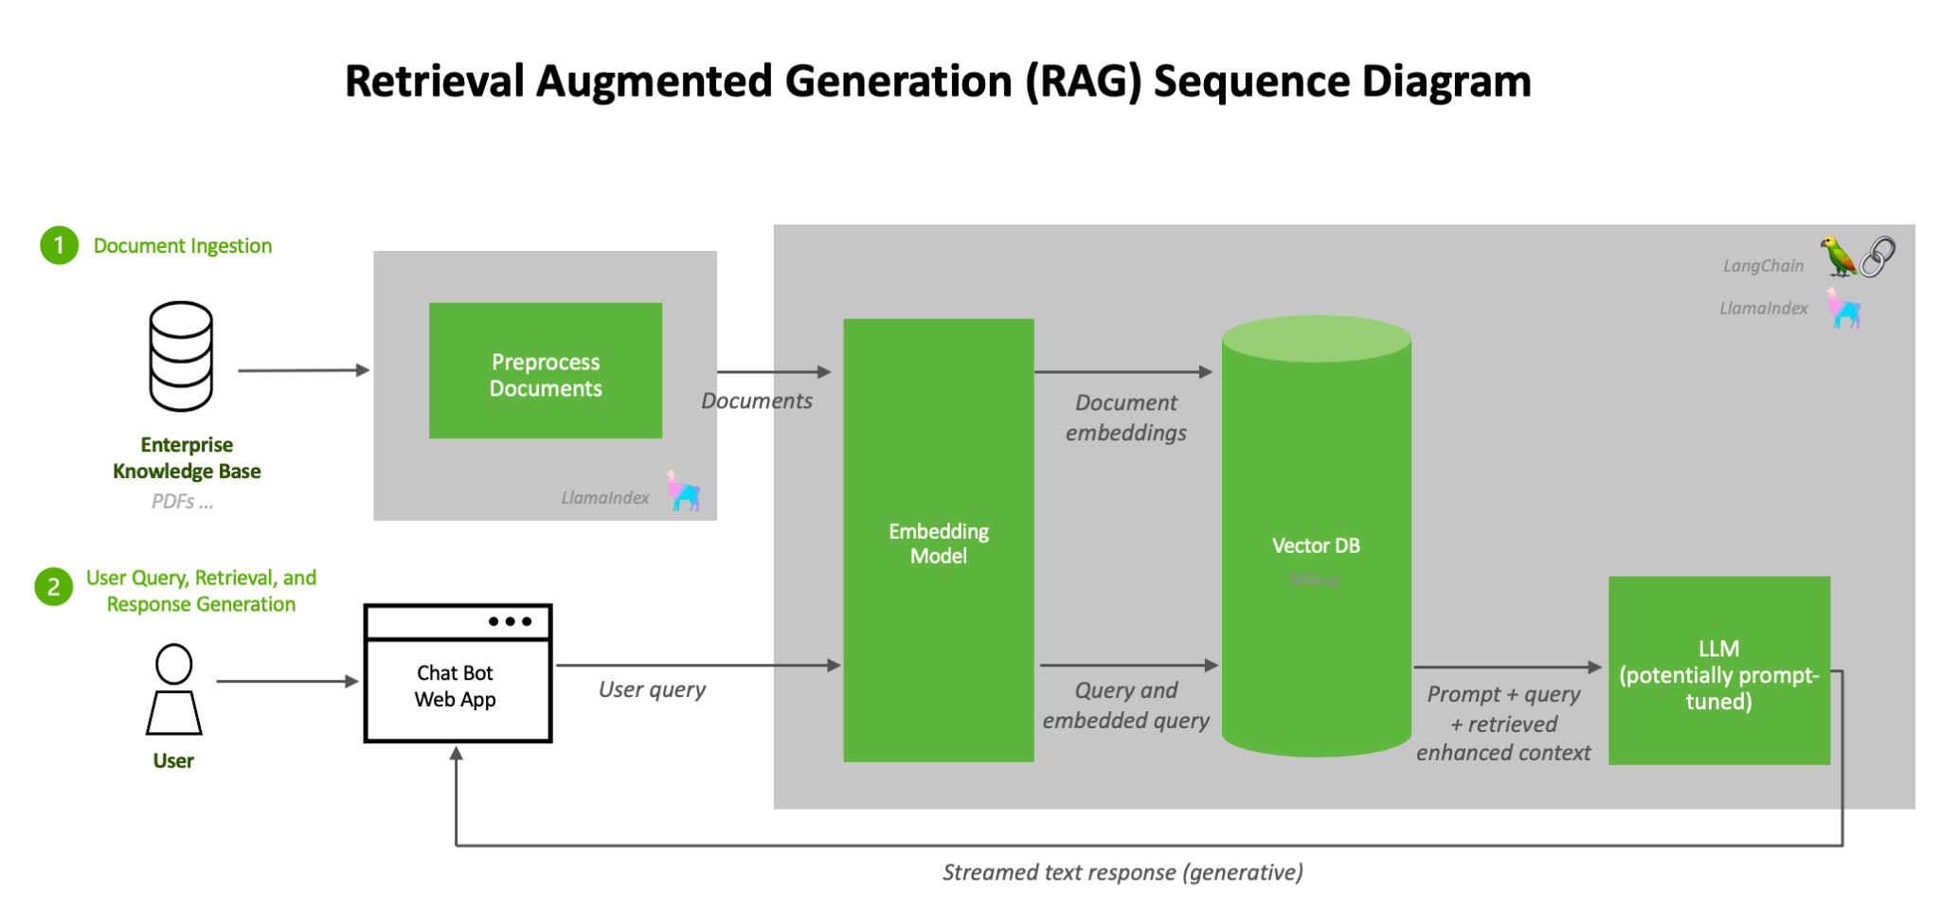
A RAG System with Dense Retriever Model
RAG systems consist of many components:
Data preprocessing
Indexing and retrieval
Generation : LLM inference with augmented input
Notes:
Welcome to our course on Building RAG Agents with LLMs!
LLMs: Large Language Models which take in, produce, or otherwise reason with text. We’ll learn to make more complex systems
Course Topics:
Creating chatbot applications capable of dialogue management and retrieval augmented generation.
Built from the ground up using foundation models which can be deployed on your own compute.
Leveraging current best practices from open-source frameworks like LangChain.

Slide 15
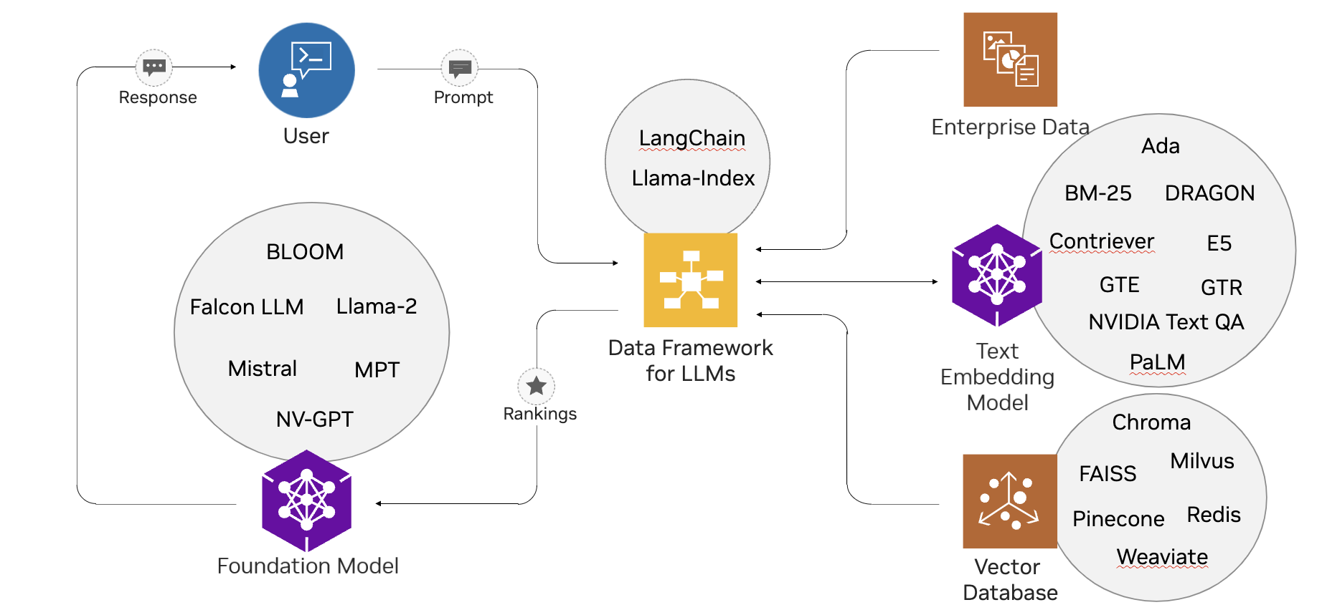
RAG Ecosystem is Complex
Enterprises must piece together solutions from open source, update and maintain them.
BGE
Notes:
NVIDIA Optimized Retrieval Improves RAG

Slide 16
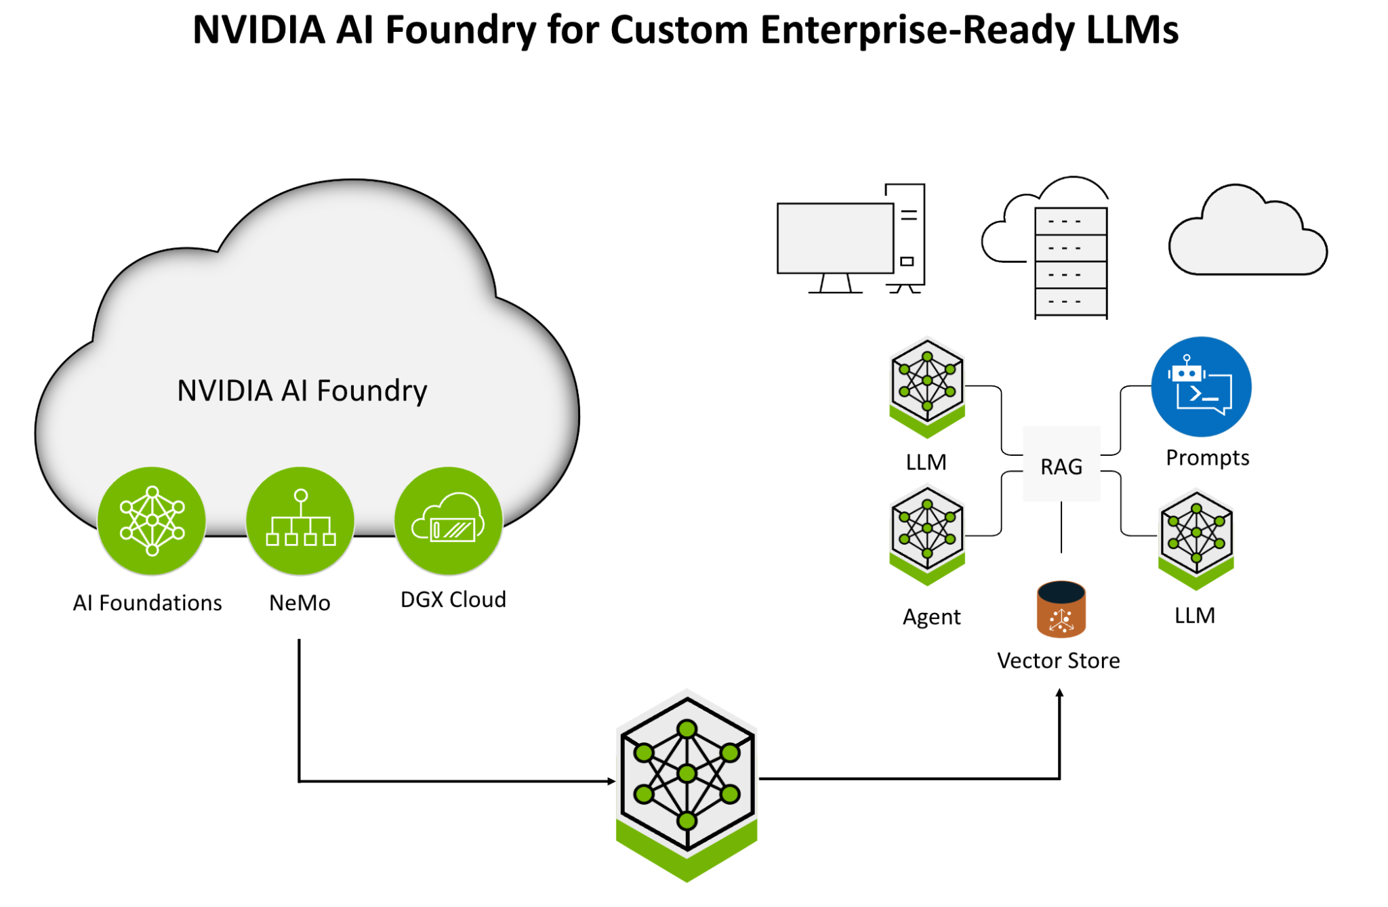
Optimized RAG applications with NVIDIA NeMo
Build, customize and deploy generative AI models with NVIDIA NeMo
Notes:
NVIDIA Optimized Retrieval Improves RAG

Slide 17
Hands on Tutorial
Part 1: Building a RAG application using NVIDIA Foundation Models & Endpoints

Slide 18
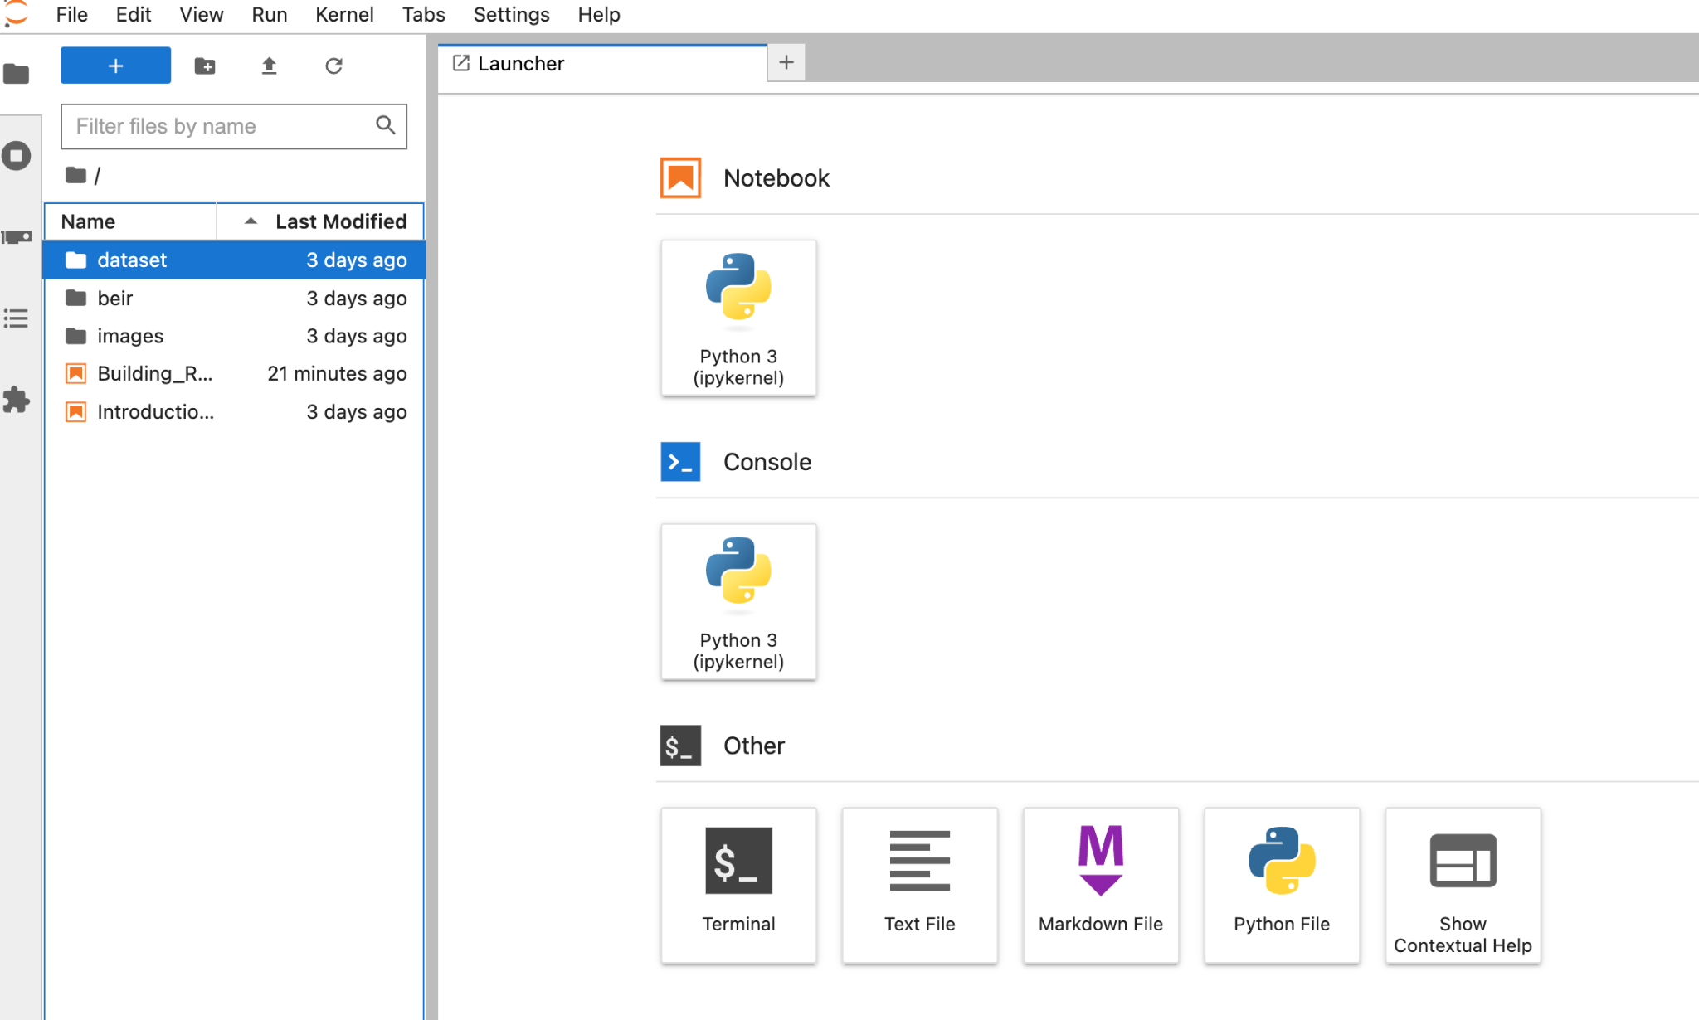
DLI Jupyter Labs Interface
Notes:
How is this interface actually provided for you?
Compute allocated for you by cloud provider like AWS or Azure. Has some hardware, os, software, etc.
Good to go!!! Except there are other things happening in the background…
Maybe data loader? Maybe proxy server? Metadata tracker? Database connection? Need different software…
Maybe some of the other resources have different requirements? Volume space? Hardware allocation?...
TO HELP SOLVE THIS, WE CAN CONTAINERIZE INTO MICROSERVICES!

Slide 19
RAG Ecosystem is Complex
Enterprises must piece together solutions from open source, update and maintain them.
BGE
Notes:
NVIDIA Optimized Retrieval Improves RAG

Slide 20
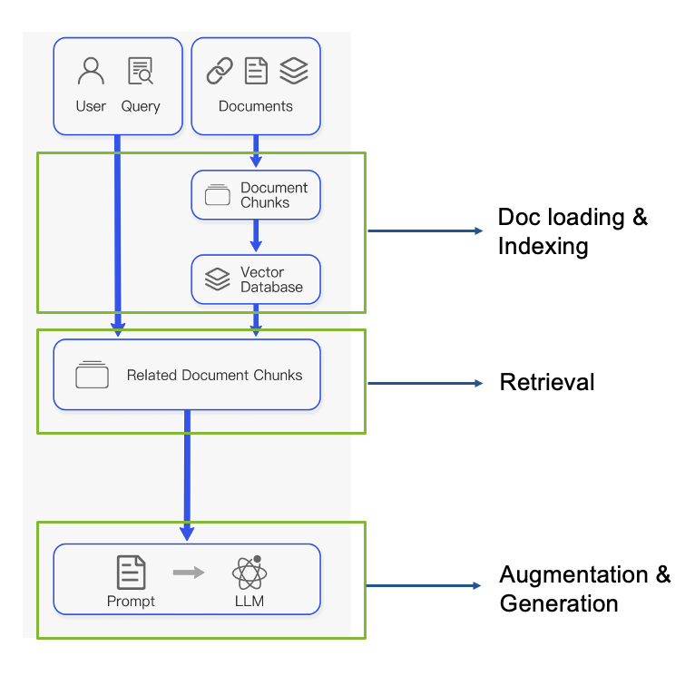
Evaluating Retriever Augmented Generators
Components can be evaluated separately
Does the retriever return the correct documents?
Public Benchmarks (MTEB/BEIR) or Private Datasets
Measure Recall@k, NDCG@k
Does the generator return the correct responses?
Requires written answer in dataset
Semantic similarity, faithfulness, groundedness
Notes:
Ways Forward:
Look over RAGAS, which has many nice examples and proposes some decent abstractions for making modular evaluator components.
For example, here’s some code you might find in the implementation. Should give some inspiration for making your own systems.
Additionally, you will probably also want to take advantage of evaluator agent loops (i.e. trajectory evaluators or multi-turn evaluators) which try to assess goodness of long-form tasks that require multiple interactions to execute. This is good to evaluate agents that are intended to progress dialog towards defined objectives.

Slide 21
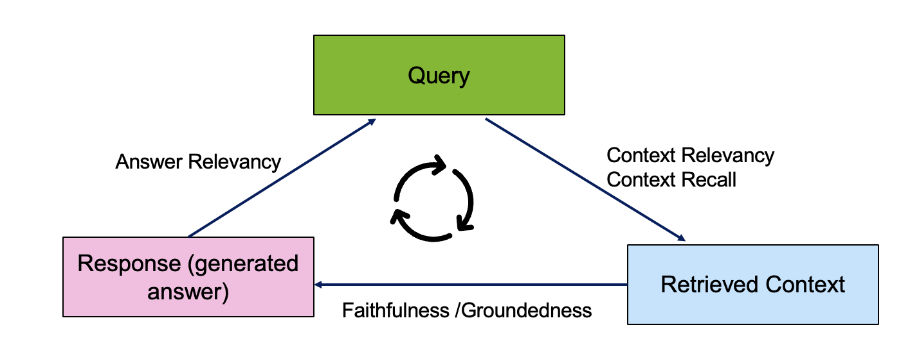
Evaluation Triad
TruLens describe the evaluation cycle
Image adapted from https://www.trulens.org/trulens_eval/core_concepts_rag_triad/
Notes:
Ways Forward:
Look over RAGAS, which has many nice examples and proposes some decent abstractions for making modular evaluator components.
For example, here’s some code you might find in the implementation. Should give some inspiration for making your own systems.
Additionally, you will probably also want to take advantage of evaluator agent loops (i.e. trajectory evaluators or multi-turn evaluators) which try to assess goodness of long-form tasks that require multiple interactions to execute. This is good to evaluate agents that are intended to progress dialog towards defined objectives.

Slide 22
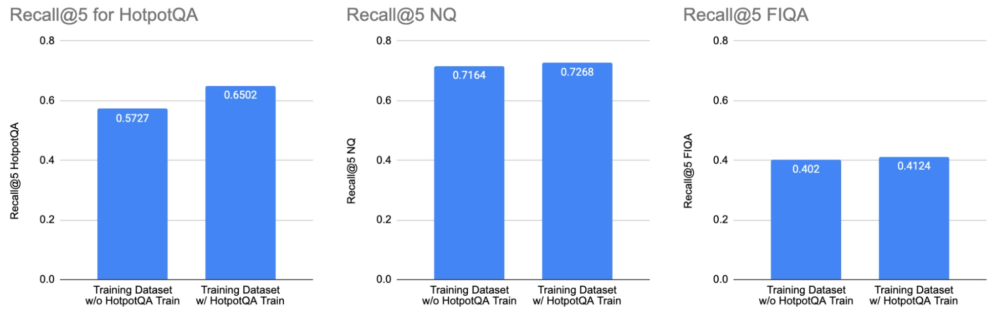
Learning from Evaluating RAG Systems
Practical Insights from building RAG applications
Choosing the correct evaluation datasets
MTEB/BEIR consists of 17 datasets, but only a few address Question-Answering Domain (NQ, HotpotQA, FIQA, NFCorpus)
Selecting the correct domain - e.g. technical documentation is different from wikipedia QA
Inspecting the dataset quality - some pairs are impossible to solve
Inspecting dataset creation - some datasets are synthetic generated with LLMs or humans wrote questions when seeing the passage
Evaluating pre-trained models and training dataset
Training on the train-dataset of the evaluation benchmark improves benchmark numbers but not necessarily the performance on other datasets
https://developer.nvidia.com/blog/evaluating-retriever-for-enterprise-grade-rag/
Notes:
Ways Forward:
Look over RAGAS, which has many nice examples and proposes some decent abstractions for making modular evaluator components.
For example, here’s some code you might find in the implementation. Should give some inspiration for making your own systems.
Additionally, you will probably also want to take advantage of evaluator agent loops (i.e. trajectory evaluators or multi-turn evaluators) which try to assess goodness of long-form tasks that require multiple interactions to execute. This is good to evaluate agents that are intended to progress dialog towards defined objectives.

Slide 23
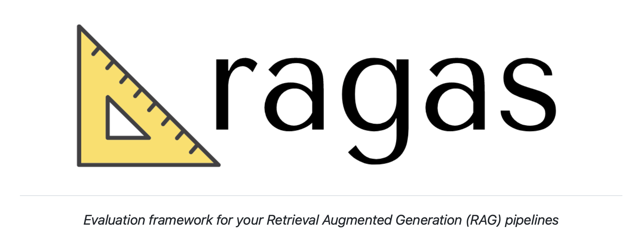
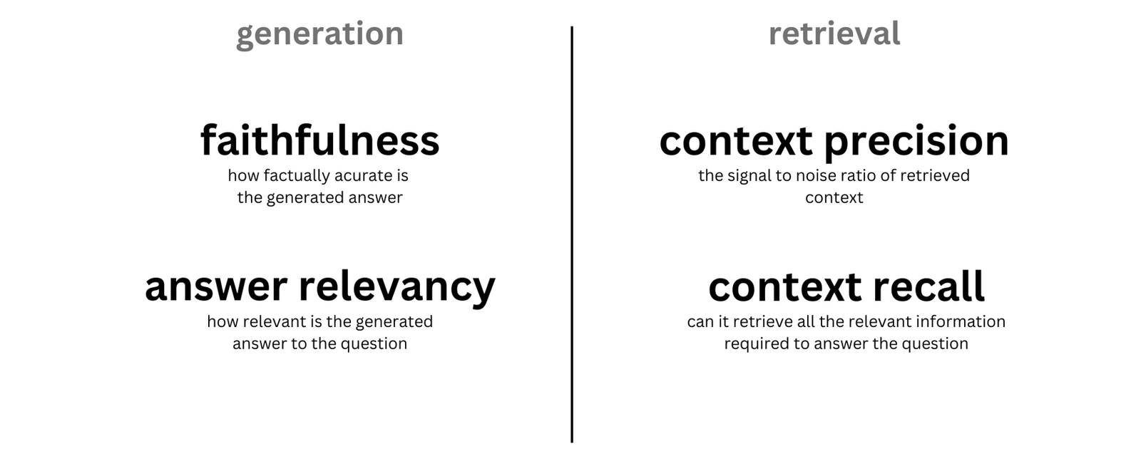
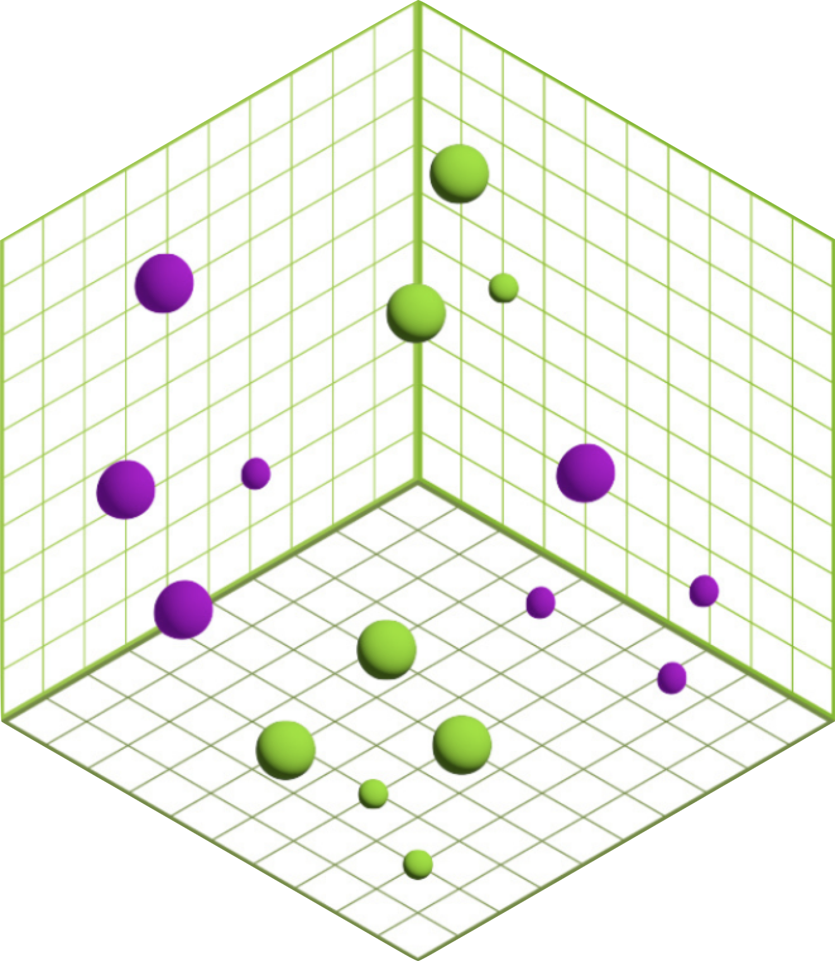
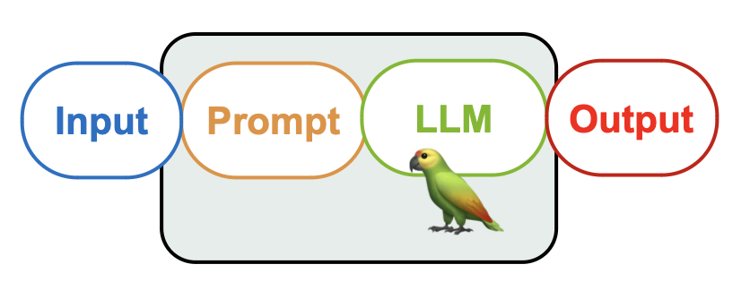
RAG Evaluation with
Quantifying System Goodness with LLM-as-a-Judge
Control
Sources
RagasEvaluatorChain
Input
Image source: Ragas documentation.
Notes:
Ways Forward:
Look over RAGAS, which has many nice examples and proposes some decent abstractions for making modular evaluator components.
For example, here’s some code you might find in the implementation. Should give some inspiration for making your own systems.
Additionally, you will probably also want to take advantage of evaluator agent loops (i.e. trajectory evaluators or multi-turn evaluators) which try to assess goodness of long-form tasks that require multiple interactions to execute. This is good to evaluate agents that are intended to progress dialog towards defined objectives.

Slide 24
Hands on Tutorial
Part 2: Evaluation

Slide 25
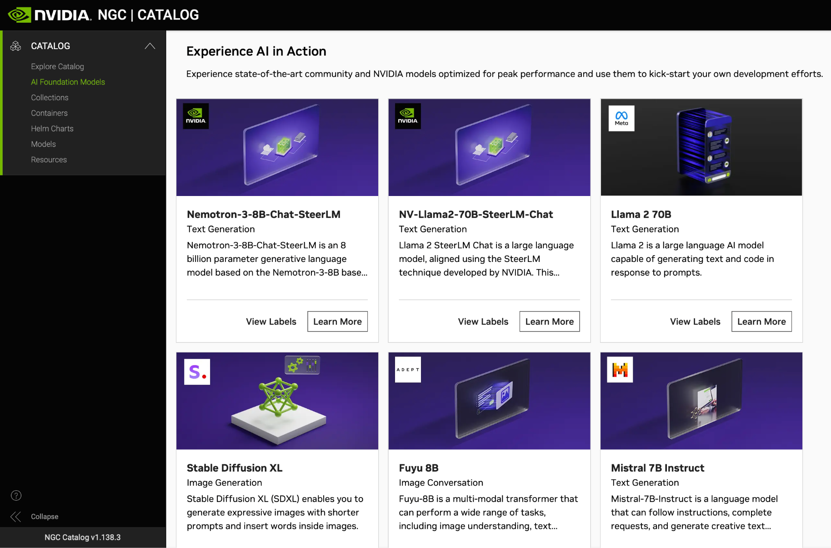
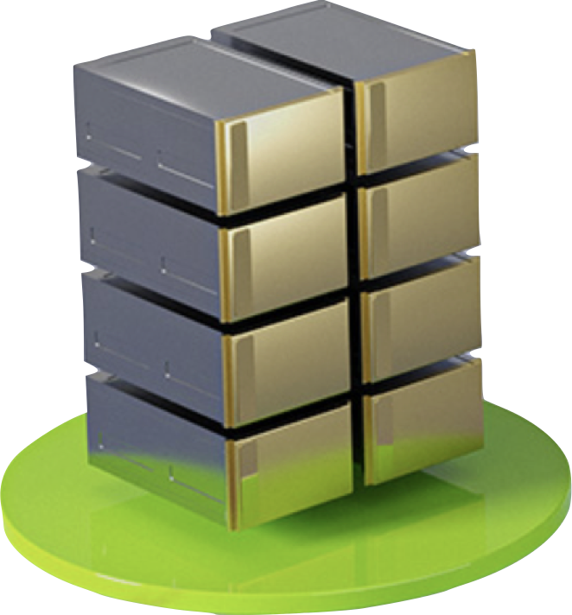
NVIDIA AI Foundation Models
NVIDIA
GPU CLOUD
Notes:
So what are we going to use to get started with some LLMs quickly?...
NVIDIA AI Foundation Endpoints!
Free access to publicly-available models which can be deployed on your own infrastructure!
Use the user interface to quickly try some models out…
… or you can even get raw access to the endpoints to try incorporating them into your own applications!

Slide 26
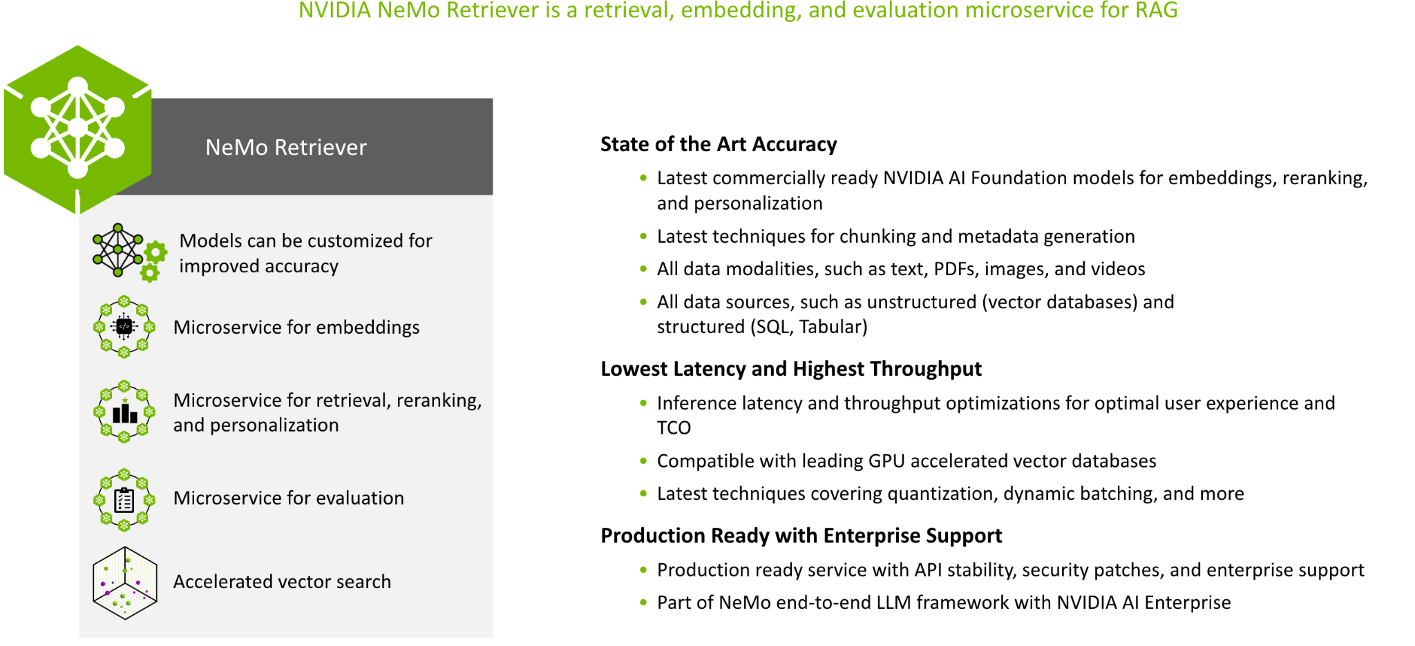
Optimized RAG applications with NVIDIA NeMo
NVIDIA Optimized Retrieval Improves RAG
Notes:
NVIDIA Optimized Retrieval Improves RAG

Slide 27
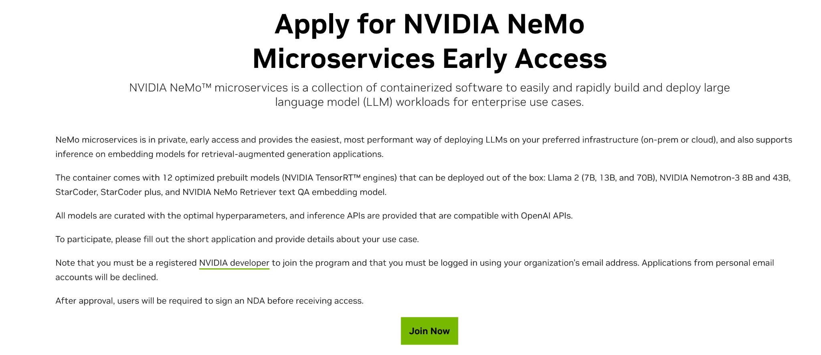
NVIDIA NeMo Microservices
https://developer.nvidia.com/nemo-microservices-early-access

Slide 28
Resources
[1] NVIDIA Retrieval QA Embedding on NGC AI Playground.
[2] Build Enterprise Retrieval-Augmented Generation Apps with NVIDIA Retrieval QA Embedding Model, NVIDIA Technical blog post.
[3] Evaluating Retriever for Enterprise-Grade RAG, NVIDIA Technical blog post.
[4] Prompt Engineering with LLaMA-2, DLI course.
[5] Rapid Application Development with Large Language Models (LLMs), DLI course
[6] Model Parallelism: Building and Deploying Large Neural Networks, DLI course.
[7] NVIDIA NeMo Microservices offers microservice spinup routines that can be deployed on local compute and function similar to AI Playground.
[8] NVIDIA AI Workbench allows for quick and simple model customization workflows that can greatly improve RAG model components for your specific use-cases.
[9] TensorRT-LLM recommended framework for deploying GPU-accelerated LLM model engines in production settings.
[10] NVIDIA Generative AI Examples GitHub repo.
[11] Building RAG Agents with LLMs, DLI course.
Notes:
Ways Forward:
Look over RAGAS, which has many nice examples and proposes some decent abstractions for making modular evaluator components.
For example, here’s some code you might find in the implementation. Should give some inspiration for making your own systems.
Additionally, you will probably also want to take advantage of evaluator agent loops (i.e. trajectory evaluators or multi-turn evaluators) which try to assess goodness of long-form tasks that require multiple interactions to execute. This is good to evaluate agents that are intended to progress dialog towards defined objectives.

